Slide 1
Agile Foundations with Scrum
Session 2: Scrum Roles Part 1

Slide 2
Manifesto for Agile Software Development
We are uncovering better ways of developing software by doing it and helping others do it.
Through this work we have come to value:
Individuals and interactions over processes and tools Working software over comprehensive documentation Customer collaboration over contract negotiation Responding to change over following a plan
That is, while there is value in the items on the right, we value the items on the left more.
Notes:
What is Agile is a question that gets asked a lot.
Agile is a buzz work that gets thrown around a lot.
At the core of all things agile is the Agile Manifesto.
If a practice, process, or tool can demonstrate that it holds true to all four of the agile values, we can confidently call it agile.

Slide 3
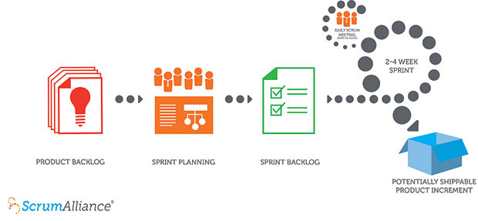
How Scrum Works
Notes:
A product owner creates a prioritized wish list called a product backlog.
During sprint planning, the team pulls a small chunk from the top of that wish list, a sprint backlog, and decides how to implement those pieces.
The team has a certain amount of time — a sprint (usually two to four weeks) — to complete its work, but it meets each day to assess its progress (daily Scrum).
Along the way, the ScrumMaster keeps the team focused on its goal.
At the end of the sprint, the work should be potentially shippable: ready to hand to a customer, put on a store shelf, or show to a stakeholder.
The sprint ends with a sprint review and retrospective.
As the next sprint begins, the team chooses another chunk of the product backlog and begins working again.

Slide 4
Roles: The Three Roles
Scrum Master: The Guide
Knows Scrum and how to make it work.
Guides the team and enforces the rules.
Product Owner: The User Advocate
Knows what the product should do and it’s value.
Sets the priorities.
Has the political will and influence to enforce priorities inside and outside of the Scrum Team.
The Team: Value Delivery
Has all the skills and expertise to build, test, and deliver the product.
Each member takes personal responsibility for the goals of the team as a whole.
Multidisciplinary.
Notes:
A Scrum Master is not a Project Manager – they do not create a schedule or report on progress to stakeholders. Stakeholder communication is managed by the Product Owner.
The Product Owner is accountable for the product roadmap, but cannot change or ignore the team’s estimates. The Product Owner can delegate some of the backlog management to the Team, but they are always in charge of setting priorities and scheduling releasesf.

Slide 5
Role Authority: Who’s in charge?
Scrum Master
The Scrum Expert – referee, coach, boundary enforcer. Not the date setter or the progress driver.
Product Owner
Owns what the product will do, and the priority of functionality. Has final say over the release schedule, but cannot override or ignore the Team’s estimates.
Team
Decides how the product will be built, shipped, and tested. The team has the final say on the how.
Notes:
The Scrum Master’s authority is in rules enforcement, not in timelines, scope control, or quality control. The Scrum Master leads from the back of the room.

Slide 6
Product Owner is One Person
Although the Product Owner can delegate just about all of the administration of the backlog to the Team, the Product Owner is accountable for the backlog. If more than one person is accountable, then no one is.
Multiple Product Owners introduces confusion and can result in wasted team effort.
A team member can administer the backlog and facilitate backlog grooming, but they cannot set priorities without the Product Owner’s approval.

Slide 7
The Balance of Power
The Development Team is accountable for the creation, deployment, and quality of the product.
They are giving the authority needed to ensure they can take the necessary steps to deliver that for which they are accountable.
Without control over the Sprint Backlog, the team can be held accountable for delivering against their own recommendations and estimates.
Without control over the technical design, test design, and implementation details, the team cannot ensure quality.

Slide 8
What Makes Teams Work
Commitment
Trust
Proximity
Patience
Personal Responsibility
Team Thinking
Notes:
Transparency and honest are key to a successful team.
A team must be given time to go through the stages of team formation:
Forming – the team moves at a slow pace as they get to know each other. This stage often has confusion and uncertainty.
Storming – often has a good deal of conflict as folks hash out roles and accountability
Norming – the team begins to hit their stride, communicate well, and build trust. Conflicts are negotiated constructively.
Performing – the team has hit their stride and begin to deliver value, communicate efficiently, and collaborate as a habit.
Transforming/Adjourning – As an increment is closed, or a project comes to an end, the team composition may be adjusted. This will put the team back into the forming stage and the cycle begins again.

Slide 9
Roles Mapping: Group Activity
On a sticky note, write down a responsibility or contribution you make to project delivery.
E.g. Write code, execute test plan, document requirements, track progress, etc.
(you can make more than one sticky if you like)
Place that sticky note below the role you think is responsible for that contribution on a Scrum Team.
Let’s talk about it.

Slide 10
1:50 PM - Retrospective
How does the burn down look?
4 Quadrants Exercise:
On a sticky note write (1 item per sticky):
What went well or not well; suggestions and shout-outs
Place on the appropriate quadrant.

